Slide 1
Week 1A – Introduction
Advanced Mechatronics System Design – MANU2451
Dr Chow Yin LAI, School of Engineering
Edited by Dr Milan Simic RMIT University, Victoria, Australia Email: milan.simic@rmit.edu.au

Slide 2
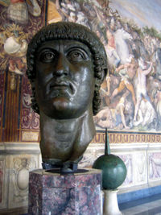
Dr Milan Simic
Dr Milan Simic, milan.simic@rmit.edu.au
Hi Honeywell, Nis, Serbia
In Roman time Naissus, Constantine the Great born there,
1700th ANNIVERSARY OF THE EDICT OF MILAN, AD 313 – 2013
I was working in: USA, GB, Germany, Portugal, Italy, Romania
R&D Institute, Nis
Electrical Engineering, Pristina
Applied Science, Maths Department, Nis
Electronics Engineering, Nis
RMIT, TCTCE, BIT, SIEBS, SAMME, CISCO L. Academy
Few Industry and 2 RMIT Awards
Contemporary
bronze head of
Constantine

Slide 3
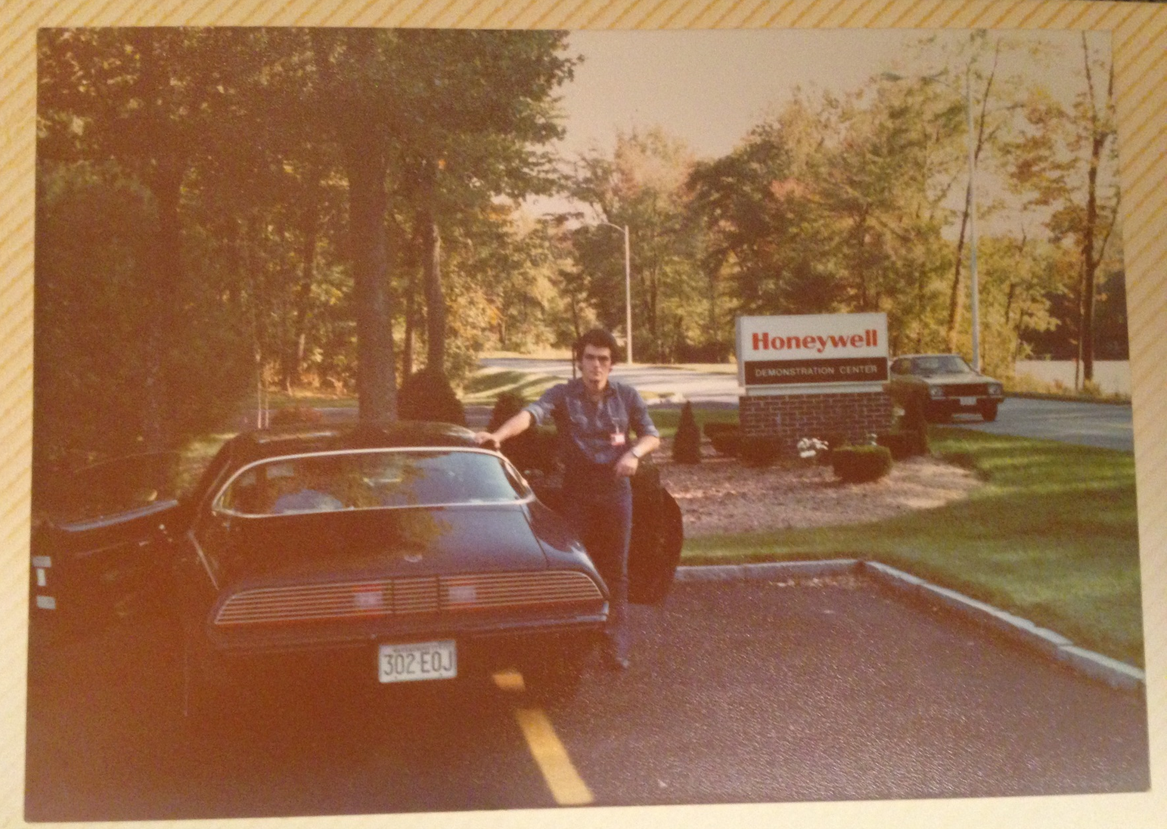

Slide 4
Activities and Recognitions
2 Ei Industry Awards for R&D,
2 RMIT Awards
Currently:
General Editor: KES Journal: http://www.kesinternational.org/journal/
Professor: University Union Nikola Tesla, Belgrade, Serbia
Adjunct Professor: Kalinga Institute of Industrial Technology (KIIT), Bhubaneswar, Odisha, India
Associate Director: Australia-India Research Centre for Automation Software Engineering
Former Program Developer and then Manager:
MC226 Master of Engineering (Management),
BH068 Bachelor of Engineering (Adv Manufacturing and Mechatronics) (Honours)

Slide 5
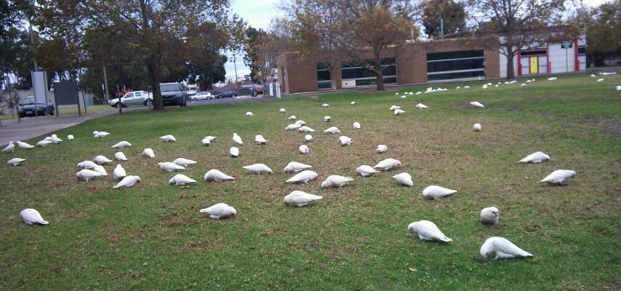
Introduce Yourself Students’ Network (Exchange contact details) Students Introduction

Slide 6
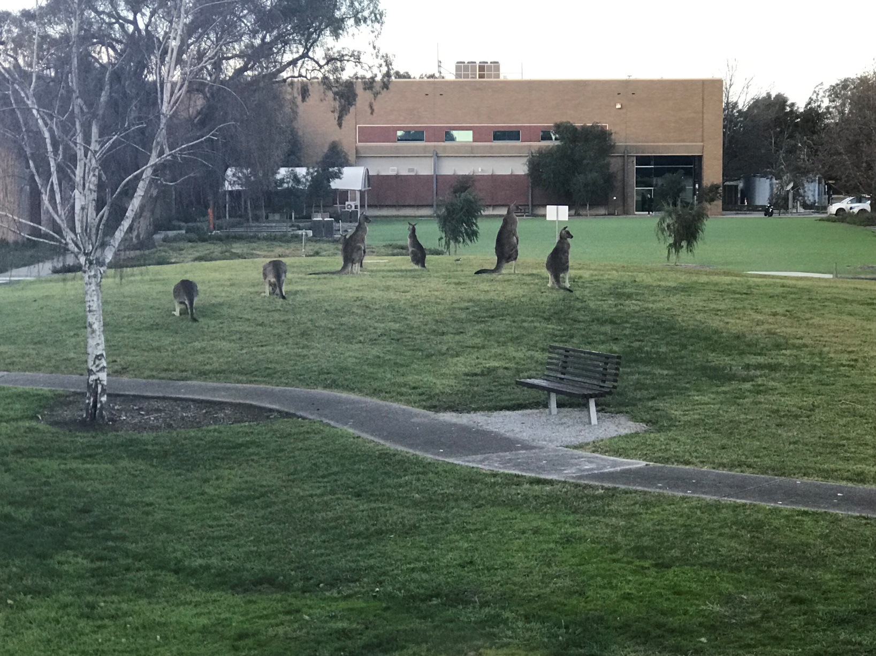
Introduce Yourself Students’ Network (Exchange contact details) Students Introduction

Slide 7
A Bit of History
Honeywell Control Systems
Process Control Systems: Industrial, Heating Cooling…
Civil and Military Avionics, Security, Sensors
Honeywell Information Systems (1960s – 1991)
First Computer Network, First Multi processor CPU (1978)
Four Honeywell DDP-516 mini computer with 12K of memory
The network was connected via 50 Kbps circuits
GCOS, Multix, Peripherals, Communications, Military
Bull HN (1991)
Honeywell from 1980; L6, DPS6 Computer Peripherals

Slide 8
Lectures
Every Wednesday 5.30pm to 6:30 followed by 6.30pm to 8:30 (9.30)pm
Venue: 056.05.094 followed by 056.04.087
Lecturer: Dr Milan Simic
Office: Bundoora East Campus, Building 251, Level 3, Room 18
Email: milan.simic@rmit.edu.au
Phone: 9925 6223
Consultation hours:
By appointment by email.
Location: At my office,
or City Campus booked meeting room.

Slide 9
About this Course
To develop an understanding in mechatronics
To have a complete round of mechatronics design
This will be achieved via a hands-on project → Robotic Gripper
You will:
Design a gripper using CAD software (Solidworks).
Fabricate the parts and assemble the gripper.
Use NI myRIO & LabView to read in sensor signals, run control algorithms, and send out control signals to the actuators.
Demonstrate the use of the gripper.
Also use MATLAB Simulink to perform simulation and control design.
Will be discussed in Week 3.

Slide 10
Teaching Schedule
Week |  | Class Activity Before | Lecture | Class Activity During or After
1 |  |  | Introduction to the Course / Introduction to LabVIEW | LabVIEW Programming
2 |  |  | Introduction to LabVIEW / Data Acquisition | LabVIEW Programming
3 |  |  | Gripper / Introduction to Solidworks / Safety | Gripper Design
4 |  |  | Sensors I | myRIO Programming for Sensor Signal Reading / Gripper Design
5 |  |  | Sensors II | myRIO Programming for Sensor Signal Reading
6 |  |  | Actuators I | 3D Printing
7 |  | LabVIEW Assessment. | DC Motors I | Matlab Simulink Simulation
8 |  | Design report submission | DC Motors II | Matlab Simulink Simulation / myRIO Programming for Control
9 |  |  | Actuators II | Matlab Simulink Simulation / Assemble Gripper
10 |  |  | Modeling and System Identification | Matlab Simulink Simulation / Test Gripper
11 |  |  | Artificial Intelligence I | Matlab Simulation / Finalize Gripper
12 |  | Gripper Demonstration / Submission of Report | Artificial Intelligent II | Revision

Slide 11
Notes
Most lectures contain virtual lab or real-world experiments. Such aspects of the lectures may not be fully reflected in the slides.
There will be discussions and interactive activities as well. You are strongly recommended to actively attend the lectures for most fruitful learning.
Consistent and active attendance in ALL lectures will significantly help you obtain a good mark in the final exam. The final exam is mainly focused on what was explained in the lectures.

Slide 12
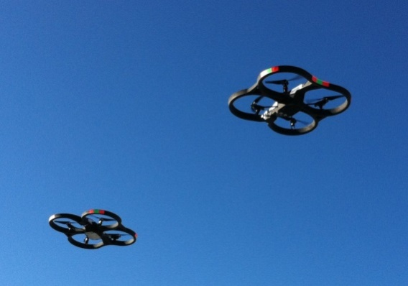
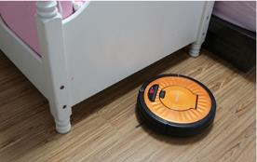
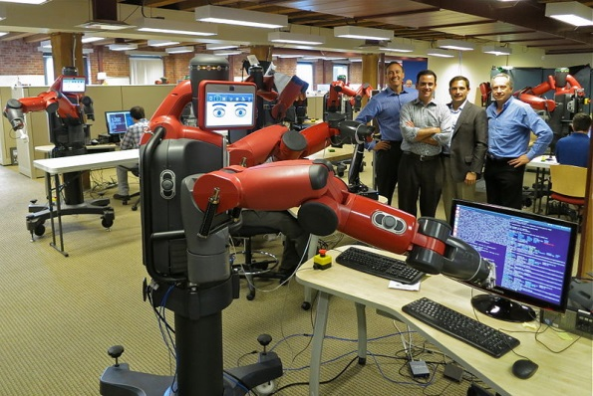
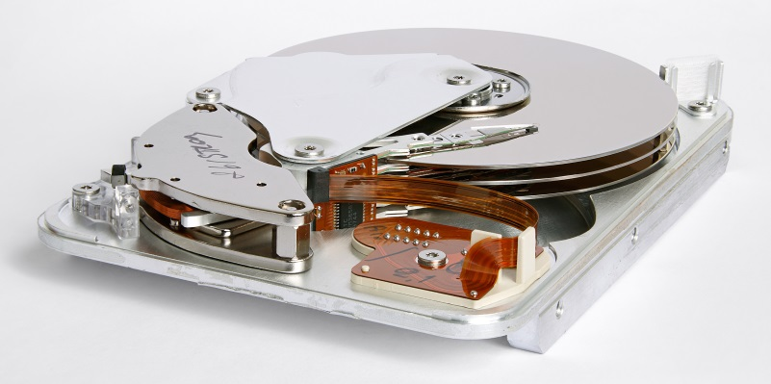
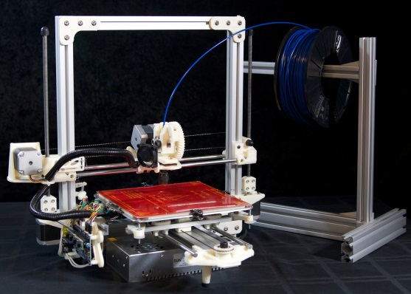
What is Mechatronics?
Drones
https://commons.wikimedia.org/wiki/File:2_Parrot_AR.Drone_2.0_in_flight.jpg
Robotic Vacuum Cleaner
https://commons.wikimedia.org/wiki/File:Mamirobot.jpg
Robot
https://commons.wikimedia.org/wiki/File:Caught_Coding_(9690512888).jpg
Hard Disk Drive
https://commons.wikimedia.org/wiki/File:Seagate_ST33232A_hard_disk_inner_view.jpg
3D Printer
https://commons.wikimedia.org/wiki/File:The_Bukobot_Reprap_3D_Printer.jpg

Slide 13
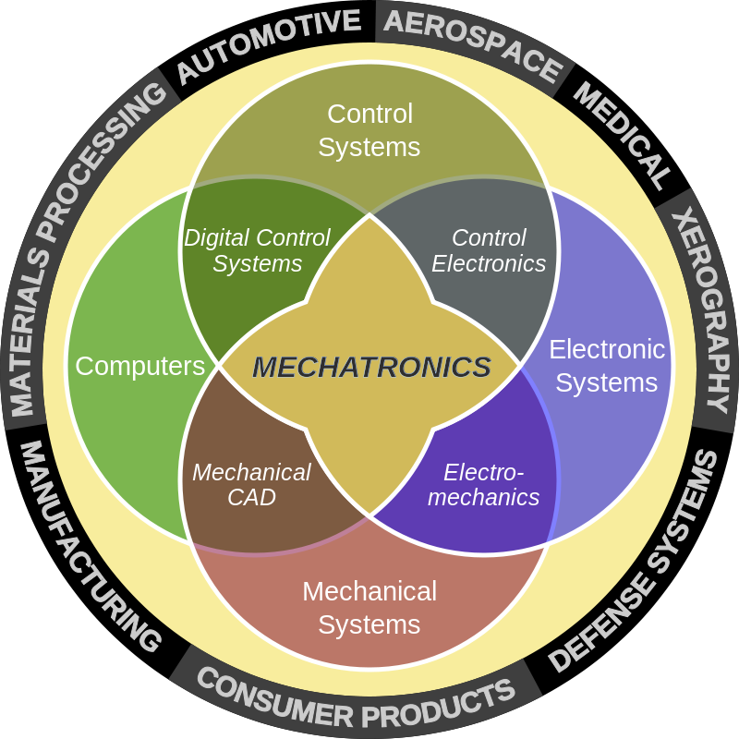
What is Mechatronics?
Electrical
Systems
https://en.wikipedia.org/wiki/Mechatronics#/media/File:Mecha_workaround.svg

Slide 14
What is Mechatronics?
Definition by IEEE:
Definition by Engineers Australia:
Mechatronics Engineering is “The Synergistic Combination of Mechanical, Electrical and Electronic Systems”.
Mechatronics Engineering is concerned with the design of automated machines. It is strongly based on a combination of mechanical, electronics and software engineering, but is a distinctly different discipline to all three.

Slide 15
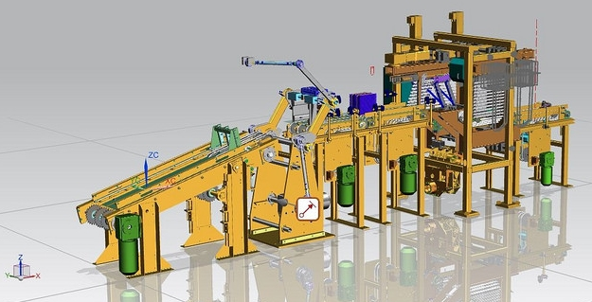
What is Mechatronics?
Possible Career:
Mechatronics Engineer / Designer
Designing robots, smart appliances, self-driving car etc.
Automation / Equipment Designer
Designing systems and equipment that can turn raw material into finished products.
Automation
https://c2.staticflickr.com/8/7260/13703982715_6fc543a8b7_b.jpg

Slide 16
Mechatronics System Components
D/A, Amplifier, PWM etc.
Output Signal Conditioning and Interfacing
Actuators
Sensors
Input Signal Conditioning and Interfacing
Digital Control Architectures
Microcontroller, Control Algorithm, PLC, etc.
DC Motor, Stepper,
Servo etc.
Mechanical
Computer
Electrical / Electronics
Control Systems
Potentiometer, Strain gauge, Encoder etc.
A/D, Filters, Amplifiers etc.

Slide 17
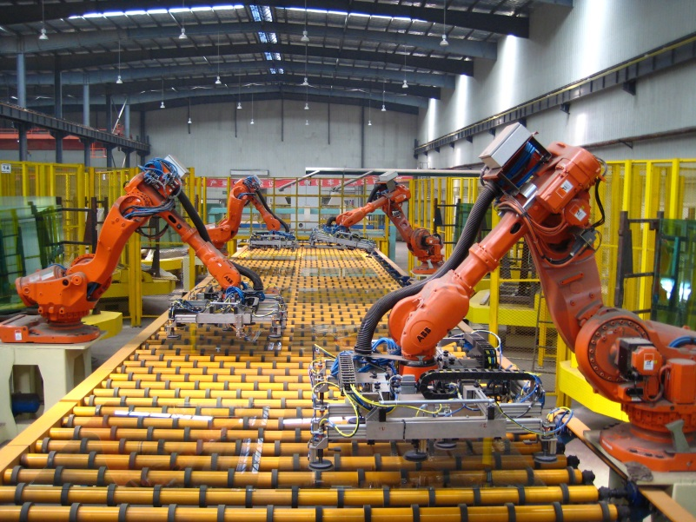
Mechatronics System Components
Sensors: Encoder at each joint
Input signal interfacing
Robot controller:
Calculate current end-effector position based on angular position (kinematics)
Generate desired motion trajectory
Calculate desired angular position for desired end-effector position and trajectory (inverse kinematics)
Control algorithm
Safety, collision detection etc.
Industrial Robots
https://commons.wikimedia.org/wiki/File:Float_Glass_Unloading.jpg
Actuators: Geared motor at each joint
Output signal interfacing

Slide 18
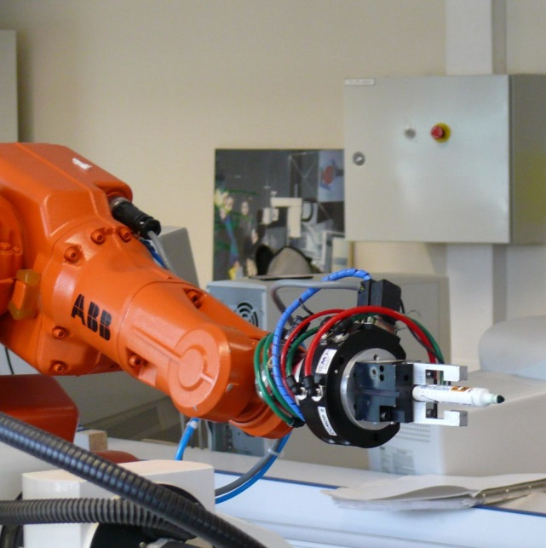
Mechatronics System Components
Sensors: Encoder, force sensor
Input signal interfacing
Controller:
Position and force control algorithm.
Logics and state machines. E.g. wait for command from robot to start gripping, send flag to robot to move after gripping is successful.
Safety, collision detection etc.
Robotic Gripper
https://commons.wikimedia.org/wiki/File:Robot_ABB_2.jpg
Actuators: Geared motor / Linear motor / Voice coil motor / Pneumatic etc.
Output signal interfacing

Slide 19
Assessment
LabView programming assessment (Individual) on week 3 (20/3) – 20%
Design assessment (Team) on Tuesday of week 5 (2/4) – 10%
A brief written report, with figures of the gripper assembly, and explanation of the components.
Also, explain choice of design, calculation etc.
Final gripper demonstration and report (Team) on week 12 (29/5) – 30%
10% and 20% respectively.
Report template is given in course folder.
Final exam (Individual) – 40%
Closed book exam.
Basic calculators allowed.
Exam not to be returned to students.
Will be on Wednesday of Week 14.

Slide 20
Peer Assessment
Note that the team assignments, i.e.
Design assessment (10%)
Gripper demonstration and final report (30%)
will have a peer assessment component.
How it works:
You will be given a group score after the initial marking.
In Week 12 or 13, I will send out a questionnaire where you will be rated by other team members based on your participation and contribution.
The final individual score will be then :
(group score) x (average rating by other team members).

Slide 21
3D Printing for Gripper Project
There are 3D printers in Building 55, Level 4.
You are NOT allowed to use the printers outside of my booked schedule – Please cooperate otherwise we may be blacklisted in the future.
How to book:
Go to https://drive.google.com/file/d/1ee9r4N6abqIRaVXTsCLzvFomXmUc8BJu/view?usp=sharing
Instruction: Enter "CourseCode_TeamNumber", e.g. MANU2451_Group02 or MIET2370_Team17
Please book only 1 printer per team.
How to print:
Please come during the agreed set-up time.
The tutor will leave at the end of the set-up time, and you will NOT be allowed to use the printers without supervision.
DO NOT LEAVE TO LAST MINUTE!

Slide 22
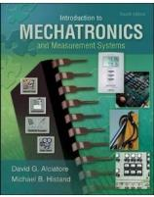
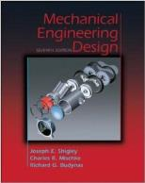
Textbooks and References
Introduction to Mechatronics and Measurement Systems by D. G. Alciatore and M. B. Histand, Fourth Edition, Publisher: McGraw Hill
Mechanical Engineering Design by J. E. Shingley, C. R. Mischke and R. G. Budynas, Seventh Edition, Publisher: McGraw Hill

Slide 23
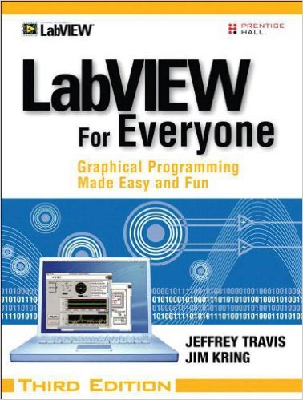

Textbooks and References
LabView for Everyone: Graphical Programming Made Easy and Fun by J. Travis and J. Kring, Third Edition, Publisher: Prentice Hall
SolidWorks 2013 Bible by M. Lombard, Publisher: Wiley

Slide 24
Textbooks and References
Introduction to Mechatronics and Measurement Systems., D. G. Alciatore and M. B. Histan., 5th / OKMcGraw-Hill Education
https://ebookcentral.proquest.com/lib/rmit/reader.action?docID=5834101
Not available download but reading online is OK.
LabView for Everyone: Graphical Programming Made Easy and Fun, J. Travis and J. Kring 3rd, Pearson Prentice Hall
https://ebookcentral.proquest.com/lib/RMIT/detail.action?docID=5187895
Full E-book.
Shigley's mechanical engineering design, Budynas, 10th SI, McGraw-Hill Education
PDF to download, E-book version of the 10th is not available. 2 copies purchased.
Solidworks 2013 Bible, M. Lombard, John Wiley & Sons
https://ebookcentral.proquest.com/lib/rmit/detail.action?docID=1129596
Not Available for Full Download, Read all is OK online.

Slide 25
Important Notes
Lecture slides and all other materials related to the course will be placed on the course website (under Canvas).
Understanding the concept and the big picture is more important than memorizing formulae.
Study constantly. Learning does not happen overnight.
You are expected to spend at least 6 hours a week working on this course.

Slide 26
Communication
As future engineers, it is important to start practising proper communication habits.
Check emails frequently.
Fix a time to do this daily, e.g. 9am or 6pm.
I use emails to send announcements sometimes, and it is important for you NOT to miss out those important emails.
Reply emails diligently.
If my emails require your responses, please reply as soon as possible.
Keep an eye on Canvas announcements too.
Try NOT to miss out important announcements.

Slide 27
Thank you!
Any Questions?

